Slide 1
Impact of Car Features
Zaid Mohammad

Slide 2
Project Description
In this project, "Impact of Car Features on Price and Profitability," the goal was to understand how different car characteristics such as engine performance, fuel type, transmission, and vehicle style affect the pricing and profitability of vehicles. By studying a wide range of features across thousands of car models, the project aims to uncover key factors that drive market value, helping manufacturers, dealers, and consumers make better-informed decisions. This analysis is important for identifying trends, recognizing high-value features, and understanding the dynamics between car design choices and their financial impact.

Slide 3
Tech Stack
MS - Excel
PowerPoint

Slide 4
Data Cleaning
Filled missing "Engine Fuel Type" based on pattern (Verona - "Regular" fuel).
Kept "Market Category" as it is ("N/A" was already used for missing).
Filled missing "Engine HP" with the median value (236).
Filled missing "Engine Cylinders" with the mode (most common value = 4).
Filled missing "Number of Doors" with the mode (most common value = 4).
Checked and removed 715 duplicate rows to avoid redundancy.
Outliers were kept because they represent real, meaningful differences (like luxury cars) and did not negatively impact the overall analysis or visualizations.

Slide 5
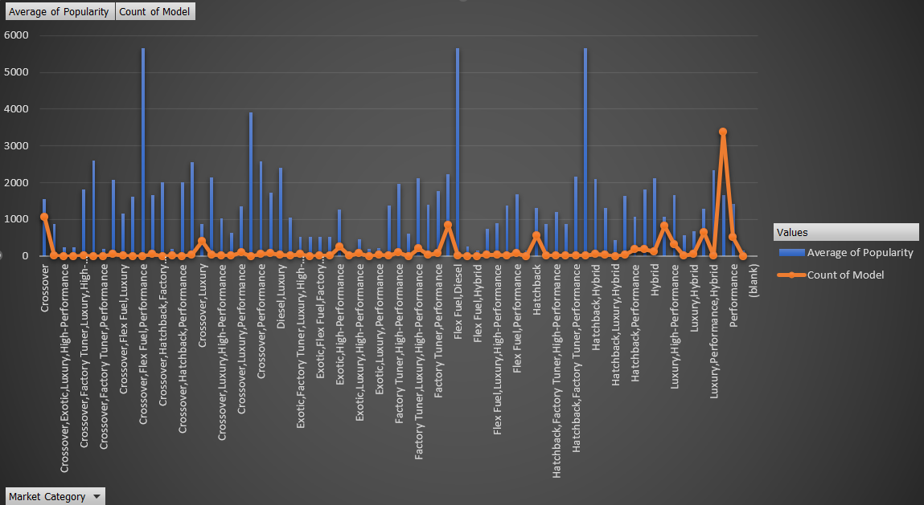
Data Analytics Tasks
Task 1(A&B) :
Insights :
Some market categories have high popularity but relatively fewer models available, indicating a potential opportunity for manufacturers.
Conversely, some categories have many models but lower average popularity, suggesting market saturation.

Slide 6
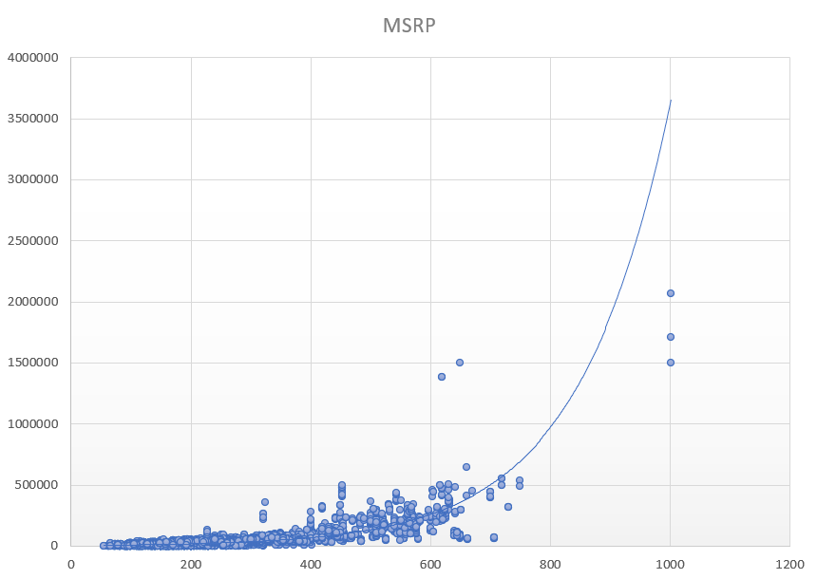
Task B: RELATION B/W HP AND PRICE
Insights :
The scatter plot indicates a generally positive correlation between horsepower and MSRP, meaning that as horsepower increases, the MSRP tends to increase as well.
Additionally, factors like Drivetrain, Vehicle Style and the presence of features affecting City MPG can also influence the final price.

Slide 7
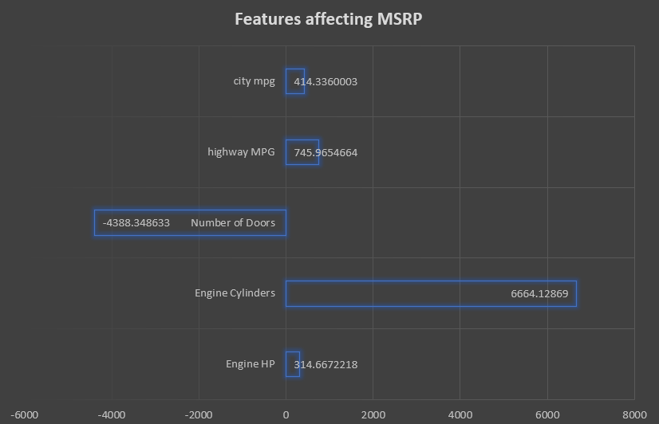
Task 3: Regression Analysis & Bar Chart - Key Features Impacting Car Price
Insights :
Fuel efficiency boosts price. Higher City and Highway MPG correlate with increased MSRP, as advanced fuel-saving tech often comes at a premium.
More cylinders, higher cost. Cars with larger engines command higher prices, reflecting their performance appeal in sports and luxury segments.
Extra doors mean lower prices. Practical 4-door models are typically cheaper than 2-door cars, prioritizing affordability over exclusivity.

Slide 8
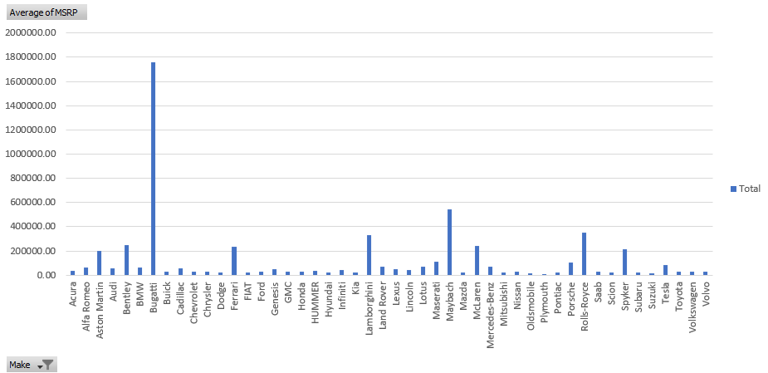
Task 4: Bar Chart - Manufacturer vs. Average Price Comparison
Insights :
Bugatti followed by Maybach and Rolls-Royce have the maximum Avg. MSRP While as Plymouth followed by Oldsmobile and Suzuki have the lowest Avg. MSRP

Slide 9
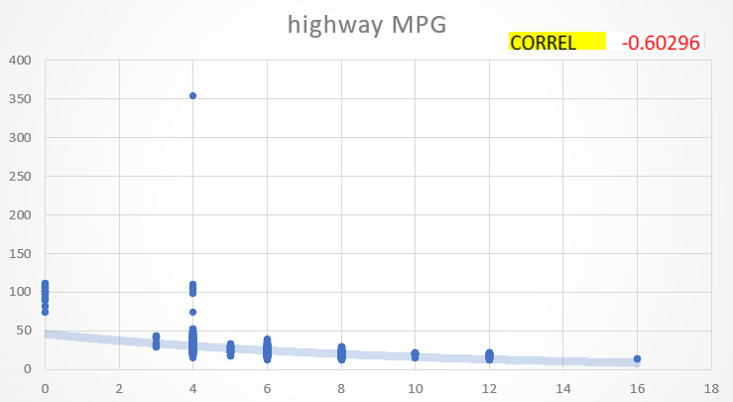
Task 5: Cylinders vs. Highway MPG
Insights :
The correlation is -0.60296(downward trend), indicating a strong relationship. The higher number of the cylinders in a car means a lower highway MPG.
And the outlier at 4 engines at 350 MPG might be due to an efficient engine or other factors.

Slide 10
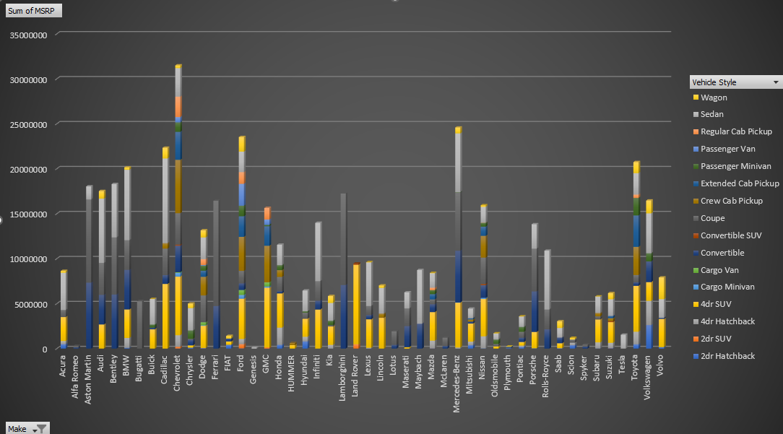
DASHBOARD TASKS
Task 1: Stacked Column Chart – Price Distribution by Brand & Body Style

Slide 11
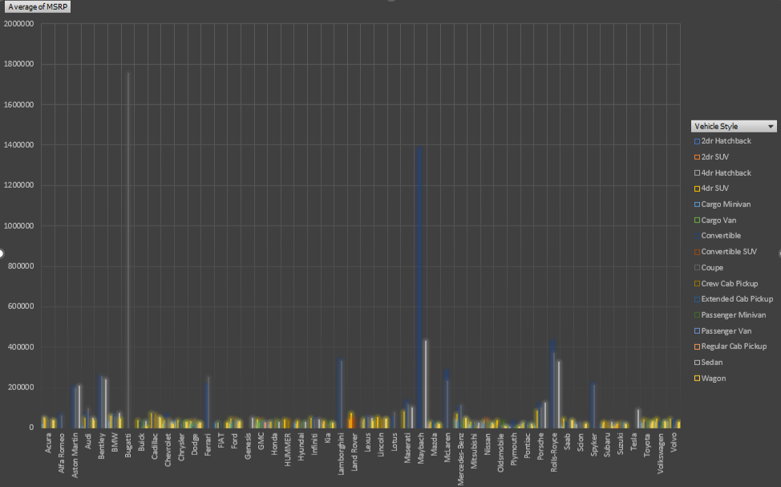
Task 2: Clustered Column Chart – Average MSRP by Brand & Body Style

Slide 12
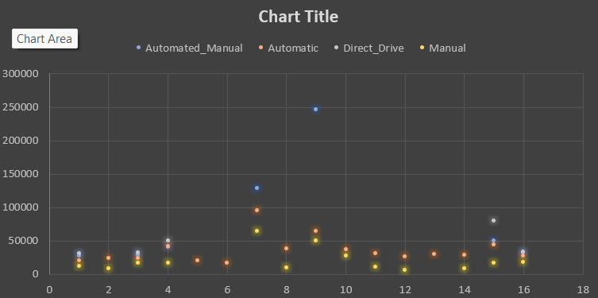
Task 3: Scatter Plot – Transmission Type vs. MSRP (by Body Style)

Slide 13
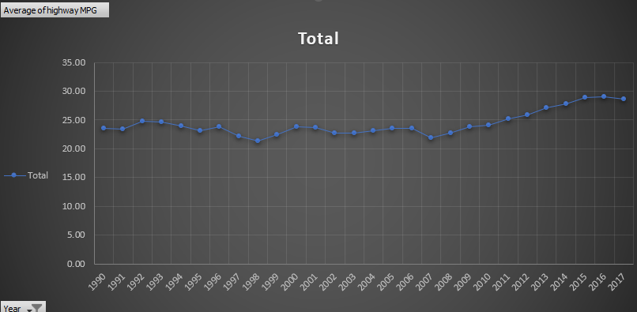
Task 4: Line Chart – Fuel Efficiency Trends by Body Style & Year

Slide 14
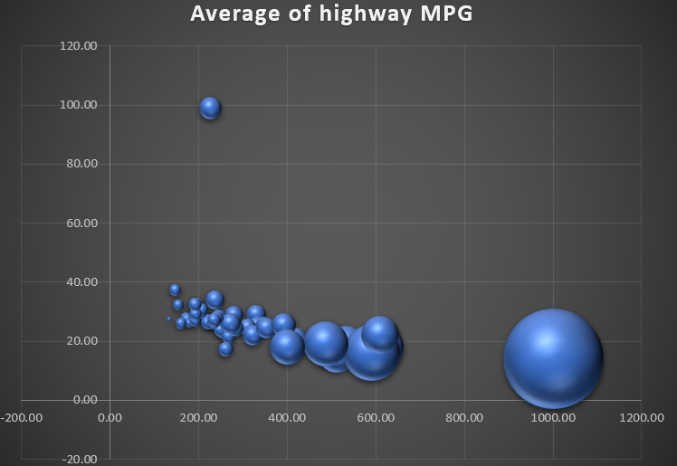
Task 5: Bubble Chart – Horsepower, MPG & Price by Brand

Slide 15
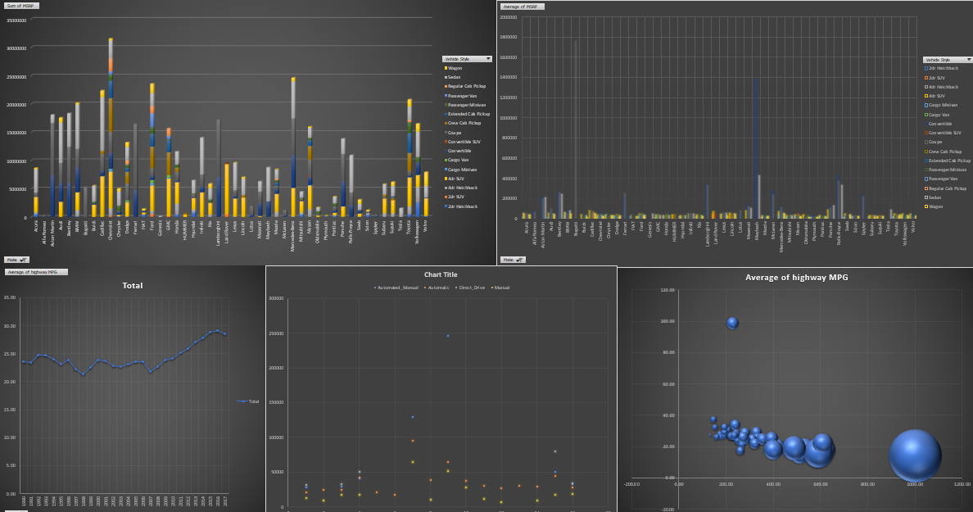
FINAL INTERACTIVE DASHBOARD

Slide 16
Insights
Through this project, I learned how various car features, such as engine power, number of cylinders, fuel type, and transmission, directly influence both the pricing and popularity of vehicles in the market. By using Excel-based data cleaning, analysis, and visualization techniques, I was able to uncover key trends like the strong impact of engine horsepower on price, and the concentration of consumer interest in specific market categories such as Luxury and Crossover. This project highlighted how data-driven insights can guide manufacturers in aligning product features with consumer demand, helping optimize pricing strategies and product development for greater profitability. Ultimately, it demonstrated the power of Excel in handling real-world business analysis problems and reinforced the importance of structured data exploration in decision-making.
Excel Sheet Link – https://docs.google.com/spreadsheets/d/1Bu9uf-hsLBDnhU3IVhmSMD7QhfxQhtfG/edit?usp=sharing&ouid=110673356967982932629&rtpof=true&sd=true

